Slide 1
Understanding buying behavior of nigerians - 2025
Presented by: Team Intermediate
Date: Saturday, 8th November, 2025.
Time: 8:30pm WAT

Slide 2
INTRODUCTION
This project analyzes buying behavior of Nigerians to understand their purchase decisions and key influencers.

Slide 3
OBJECTIVES
The following are the objectives of this project:
Understand Nigerians’ shopping patterns
Identify preffered shopping platforms and payment methods
Examine key factors influencing buying decisions
Compare behavior across gender, age and income level

Slide 4
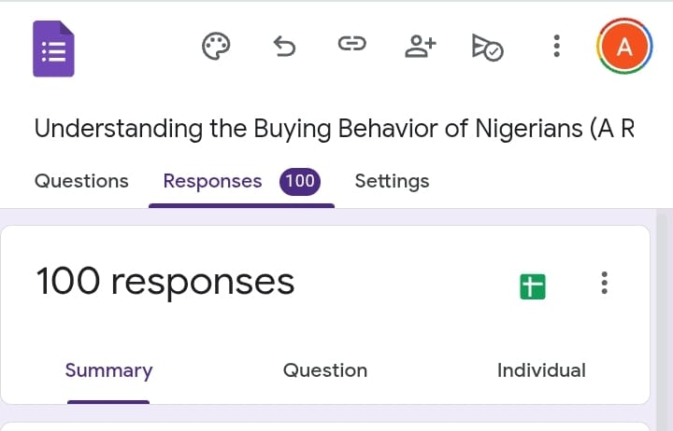
DATA COLLECTION
Google forms was used to collect data from the field. A total of 100 respondents were gotten and the analysis was based on the data collected.

Slide 5
DATA CLEARNING AND PREPARATION
Excel and Power BI were used in cleaning the collected data by:
Removing duplicates
Standardizing categories
Correcting spelling inconsistencies
Creating calculated measures in Power BI

Slide 6
RESULTS & KEY INSIGHTS
Based on the analysis conducted, the following key results were observed:
Physical store/market is the most preferred shopping channel
Food is the most purchased product
Necessity is the top influencer of decision
Bank transfer is the most preffered payment method (70%+)
Female shop slightly more frequently than male
Higher income earners shop less often but spend more per purchase

Slide 7
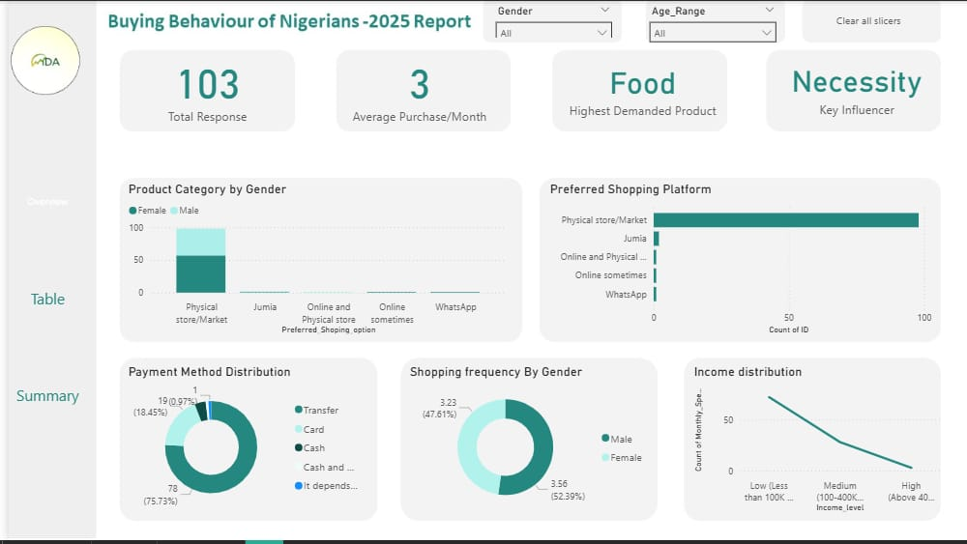

Slide 8
RECOMMENDATION
Businesses should:
Strengthen their physical store experience
Increase digital marketing for youth
Maintain transfer payment option for conveniency
Use influencer marketing for female audience.

Slide 9
CONCLUSION
The project reveals that Nigerian consumers prioritize necessity, convenience and trust when making purchase decisions, with physical store and bank transfers dominating preferences.

